Slide 1
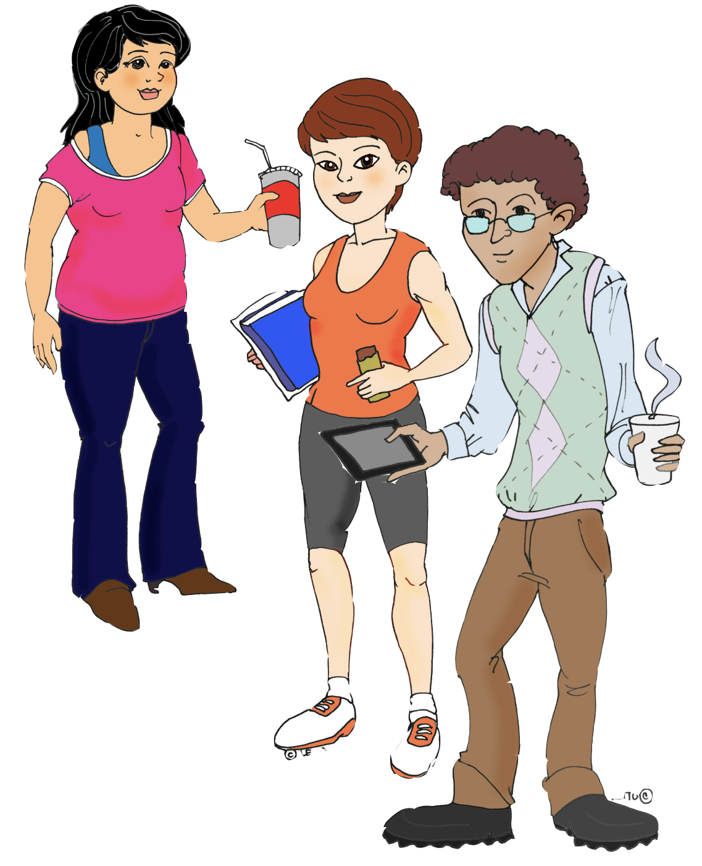
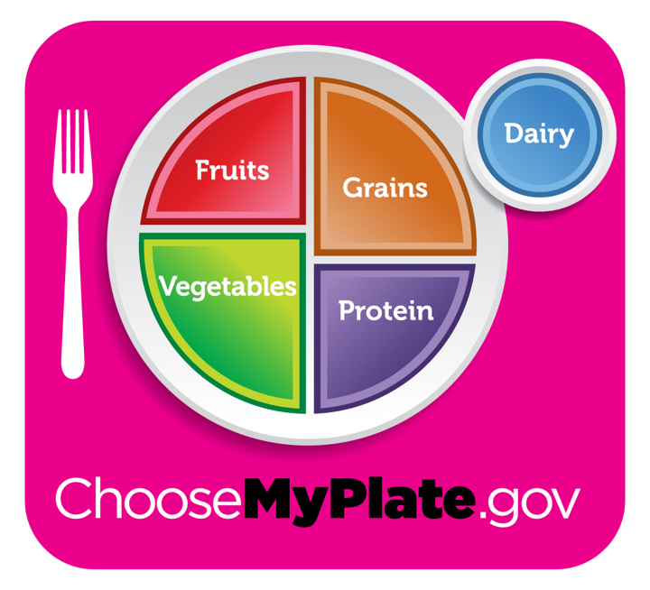
Metabolic Diseases Lesson 1.6
Nutrition and caloric needs are impacted by lifestyle - MyPlate

Slide 2
Do Now
In your group, discuss what it means to eat healthily

Slide 3
Daily recommended calories
How many calories does a person need everyday?
What information is used to calculate the number?

Slide 4
Daily recommended calories
How many calories does a person need everyday?
What information is used to calculate the number?
Gender
Age
Height
Weight
Physical activity

Slide 5
Daily recommended calories
If the daily number of recommended calories are different for different people, is there such a thing as a good diet or a bad diet?
Are there good and bad calories?

Slide 6
Activity MyPlate Case Studies
Lets meet our characters - Mimi, Oliver, and Edna.
What did they eat yesterday? And how does it compare to MyPlate recommendations for calories?
Does it fulfill their nutritional requirements?
If not, how can we fix it?

Slide 7
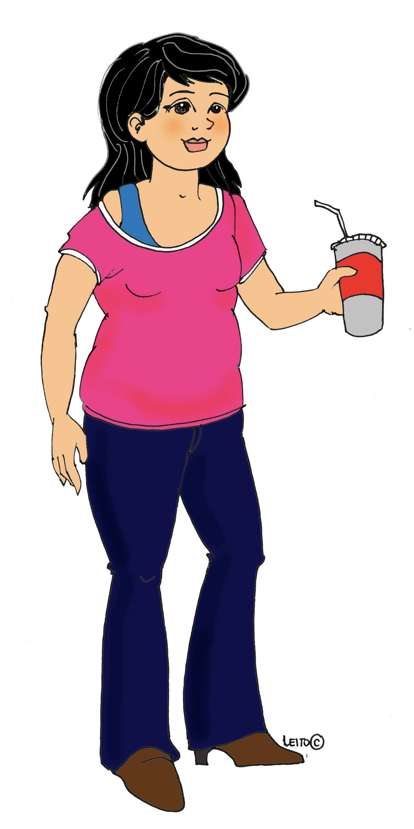
Mimi
Age 17
Gender female
Height 5ft 4in
Weight 155lb

Slide 8
Mimi
Mimi’s mom cooks for the family and makes sure Mimi eats a good dinner.
The trouble is that Mimi has a sweet tooth and always gets hungry between meals.
Physical activity: less than 30 min/day moderate intensity exercise.

Slide 9
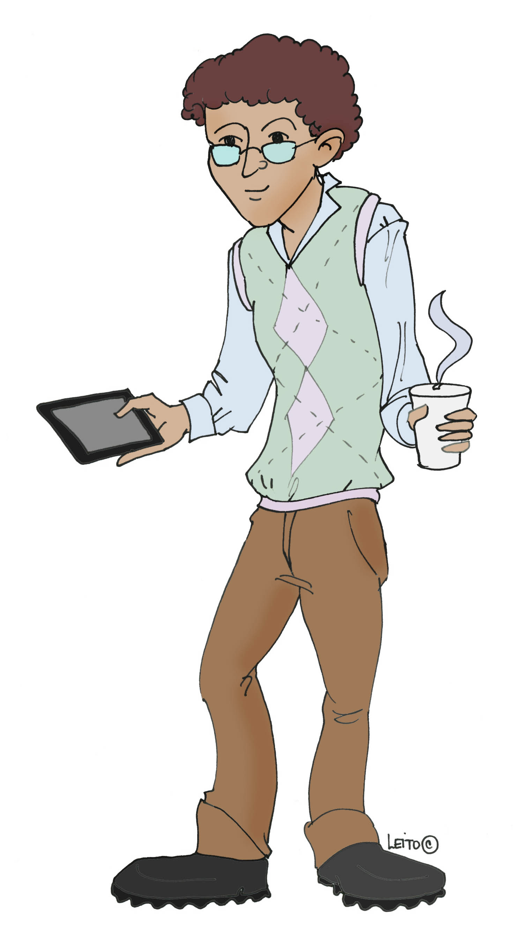
Oliver
Age 16
Gender male
Height 5 ft 9in
Weight 190lb

Slide 10
Oliver
Oliver is always behind schedule and is constantly rushing around so he often eats on the fly.
He rarely sits down to a home-cooked meal.
Physical activity: More than 60 min/day moderate intensity exercise.

Slide 11
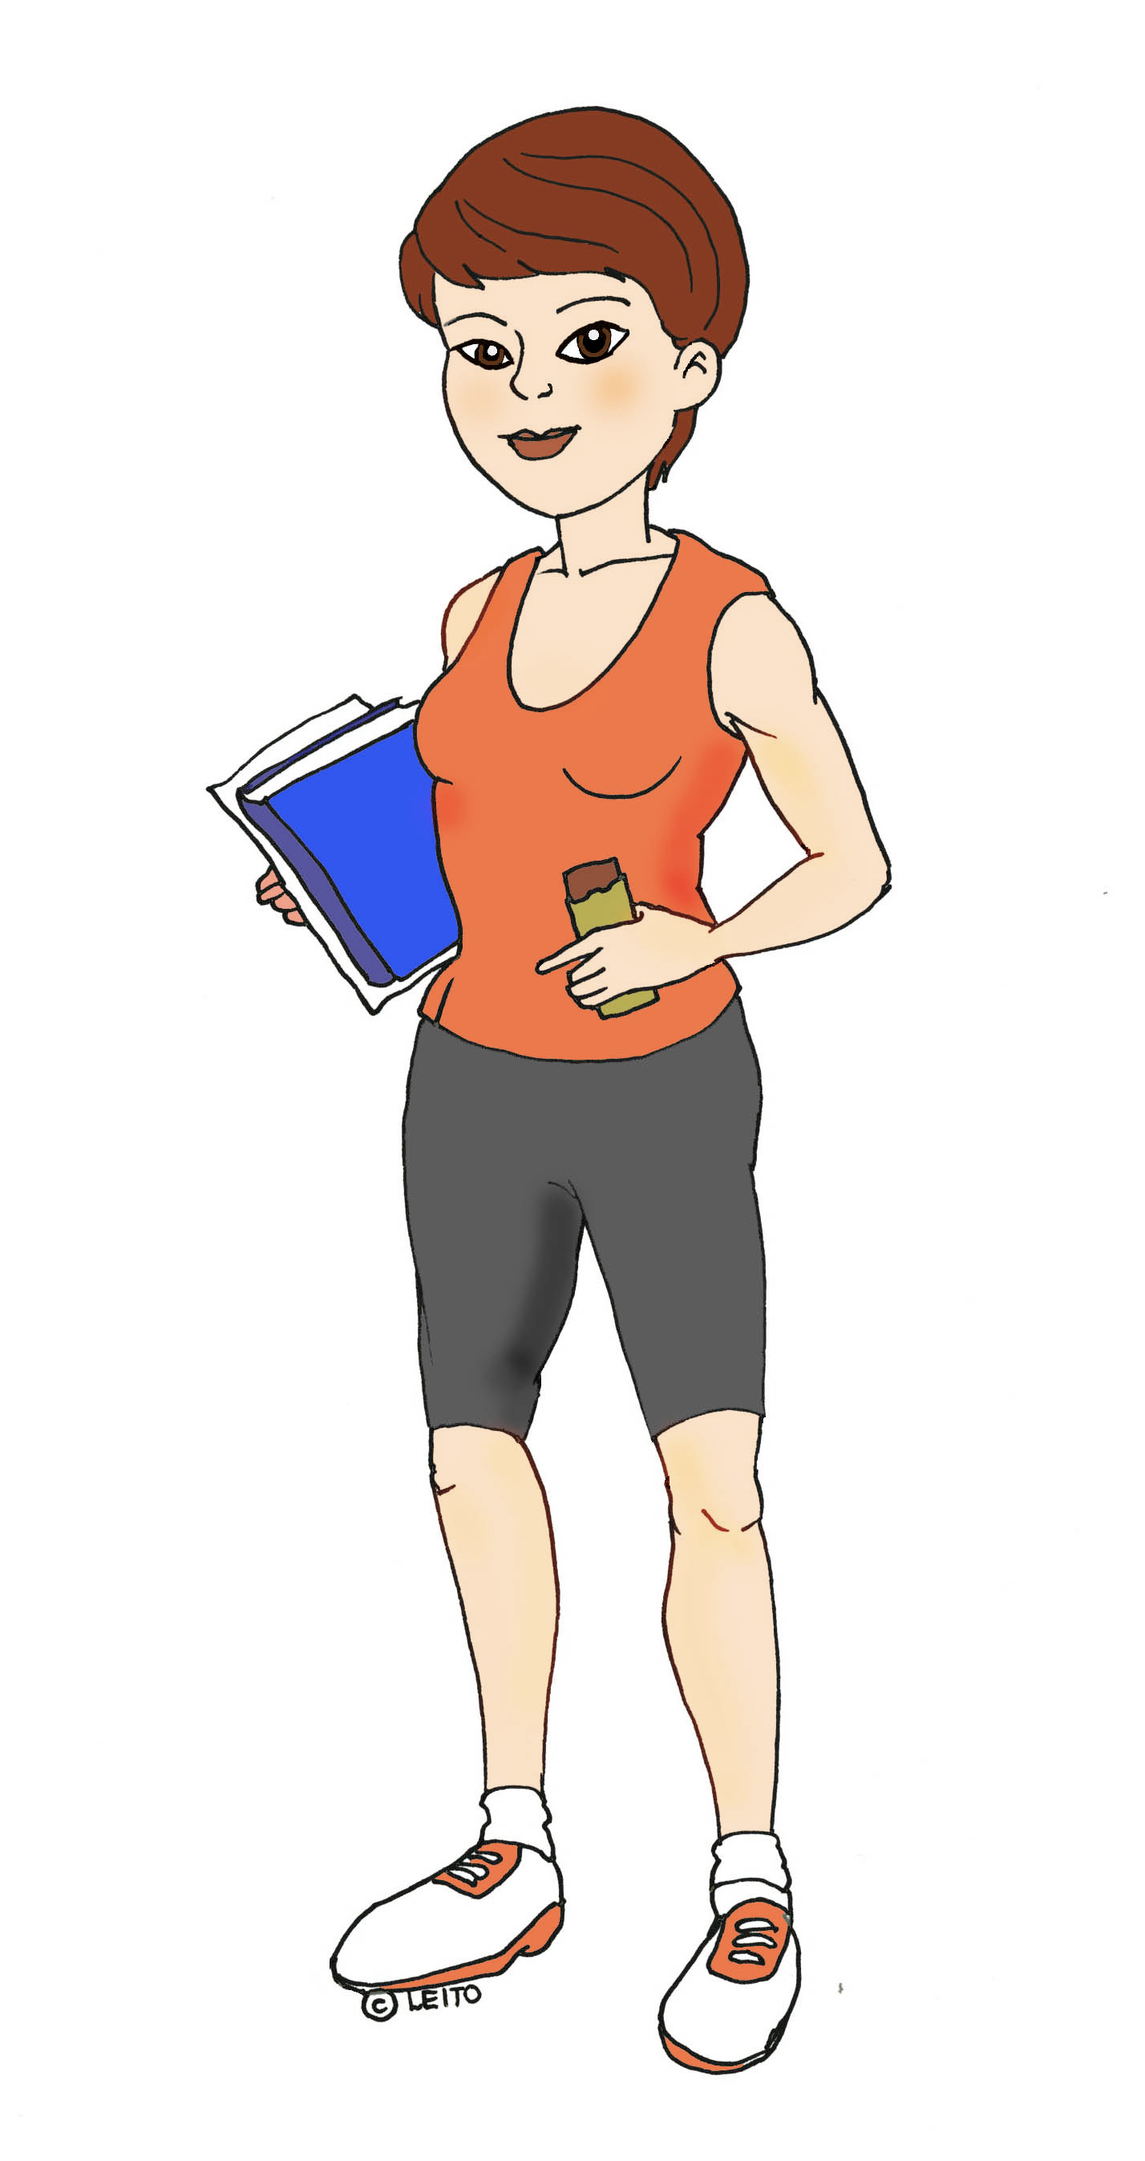
Edna
Age 17
Gender female
Height 5ft 7in
Weight 140lb

Slide 12
Edna
Edna is on two varsity teams and also has a lot of work to do.
She’s serious about exercise and pays attention to what she eats.
Physical activity: More than 60 min/day high intensity exercise.

Slide 13
Mimi, Oliver and Edna
Cals | Sex | Age | Height | Weight | Exercise
Mimi | Female | 17 | 5’4” | 155lb | < 30min moderate
Oliver | Male | 16 | 5’9” | 190lb | > 60min moderate
Edna | Female | 17 | 5’7” | 140lb | < 60min intense

Slide 14
Do Mimi, Oliver and Edna need different amounts of nutrients?
How are they doing?

Slide 15
Mimi, Oliver and Edna need different amounts of calories
Cals | Sex | Age | Height | Weight | Exercise
Mimi 1800 | Female | 17 | 5’4” | 155lb | < 30min moderate
Oliver 3200 | Male | 16 | 5’9” | 190lb | > 60min moderate
Edna 2600 | Female | 17 | 5’7” | 140lb | < 60min intense
Are they getting them?

Slide 16
Worksheet
Look at the food consumed by each person. Complete the worksheet in table groups and predict calorie balance.
Look and the analysis of nutrient intake and complete the table in the worksheet.

Slide 17
Not so well!
Cals | Cals | Macronutrients | Vitamins | Minerals | Empty cals
Mimi 1800 | 3039 | Okay | Low: D, E, K, B (Choline) | High: Na | Over!!!
Oliver 3200 | 2991 | Low: Fiber, Linoleic Acid | Low: A, C, D, E, B (Choline) | Low: Ca, K, Mg High: Na | Over!!
Edna 2600 | 2041 | Low: Total Fat | Low: E High: A, B (Folate) | Low: K | Okay
What foods might fix the problem?

Slide 18
Wrap Up
What is an empty calorie?
Can you find a relationship between empty calories and other nutrient deficiencies in today’s worksheet?
What are the key points from this lesson?
Diets can be high in calories and low in nutrients.
Caloric needs are impacted by lifestyle.

Slide 19
Wrap Up
To be able to make healthy choices we need to know what is in our food.
What does this mean?

Slide 20
Wrap Up
To be able to make healthy choices we need to know what is in our food.
What does this mean?
Macronutrients and micronutrients.
Additives, and whether they’re necessary or not.
Contaminants

Slide 21
Wrap Up
To be able to make healthy choices we also need to know what our body does with our food once we’ve eaten it.
We’ll learn about this in Unit 2.

Slide 22
Homework
Give five suggestions as to how Mimi, Edna OR Oliver might change their diet.
Start your own MyPlate Log using the unit 1.6 homework sheet. You will need to record everything you eat for the next 10 days.

